Slide 1
Data Analysis & Visualisation
BY Harsh

Slide 2
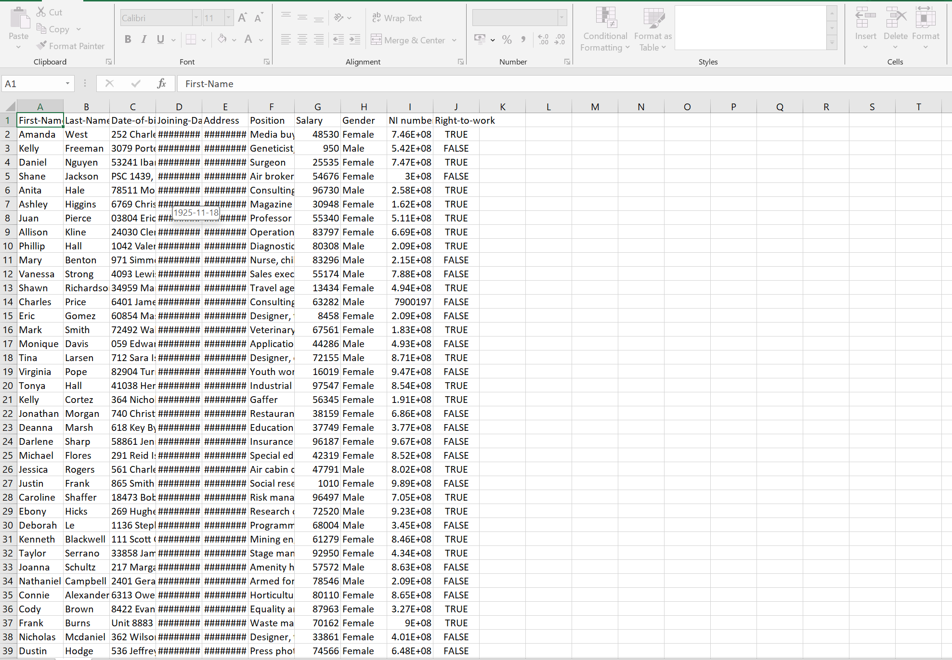
Know the data
The first thing to do when analysing the data is to familiarise yourself with the data.

Slide 3
Know the problem
As per Equality Act 2010, its unlawful to discriminate against anyone based on the protected characteristics:
Race
Age
Gender
Religion
Disability
Marital status
Sexual Orientation
Pregnancy
The problem in this case is to identify indicators of discrimination within the organisation.

Slide 4
Link the data with the problem
I have noticed that some of the data fields matches with the protected characteristics.
Age
Gender
I have also noticed another data field which may also indicate a form of discrimination.
Joining Date
(New joiners can face form of discrimination from people who are within the business for long time)

Slide 5


Which data fields will help to identify discrimination?
or
Which data fields shows the effect of the discrimination?
Salary
Demographics of company

Slide 6

Questions
Does age impact an employee’s earnings?
Do older employees people earn less?
Do younger employees people earn less?
Does males get more salary than females in same position?
Does employees with longer time with the company get more salary than new joiners?
Does the organisation hire more males than females?
Are there more young employees than older employees?

Slide 7

Cleaning Data

Slide 8
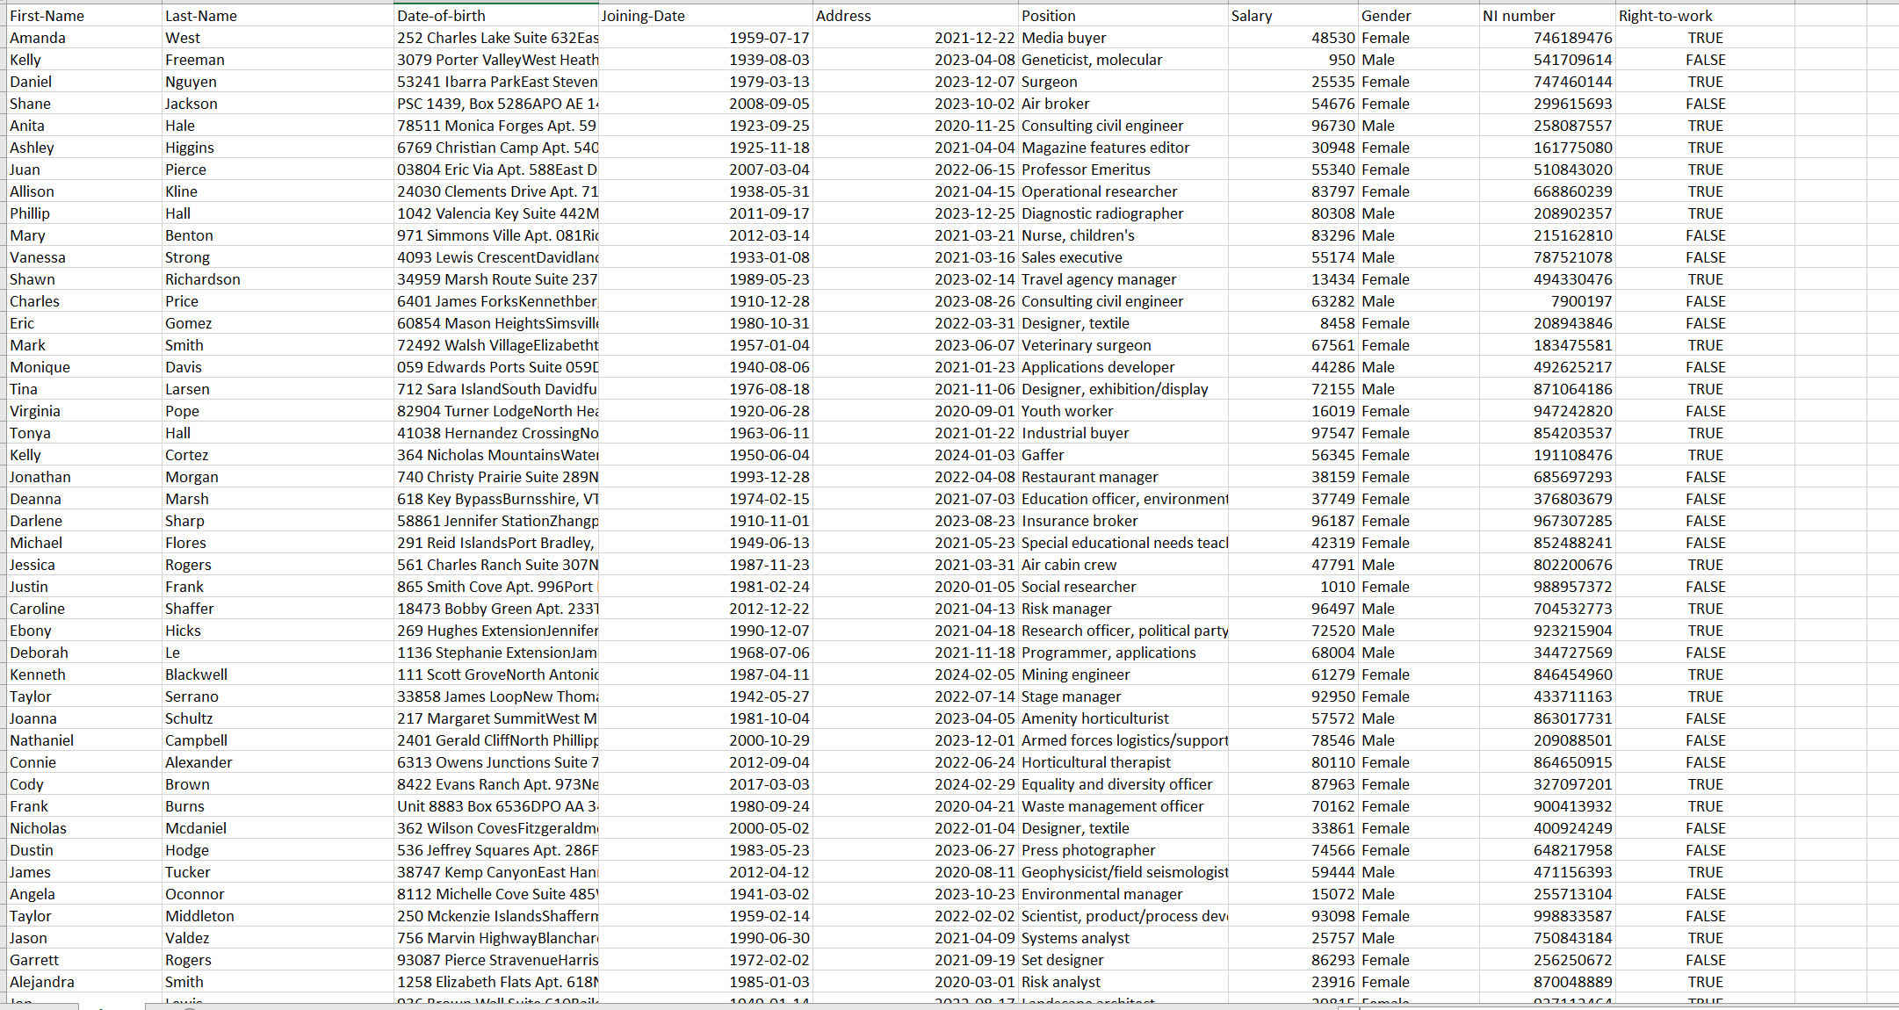
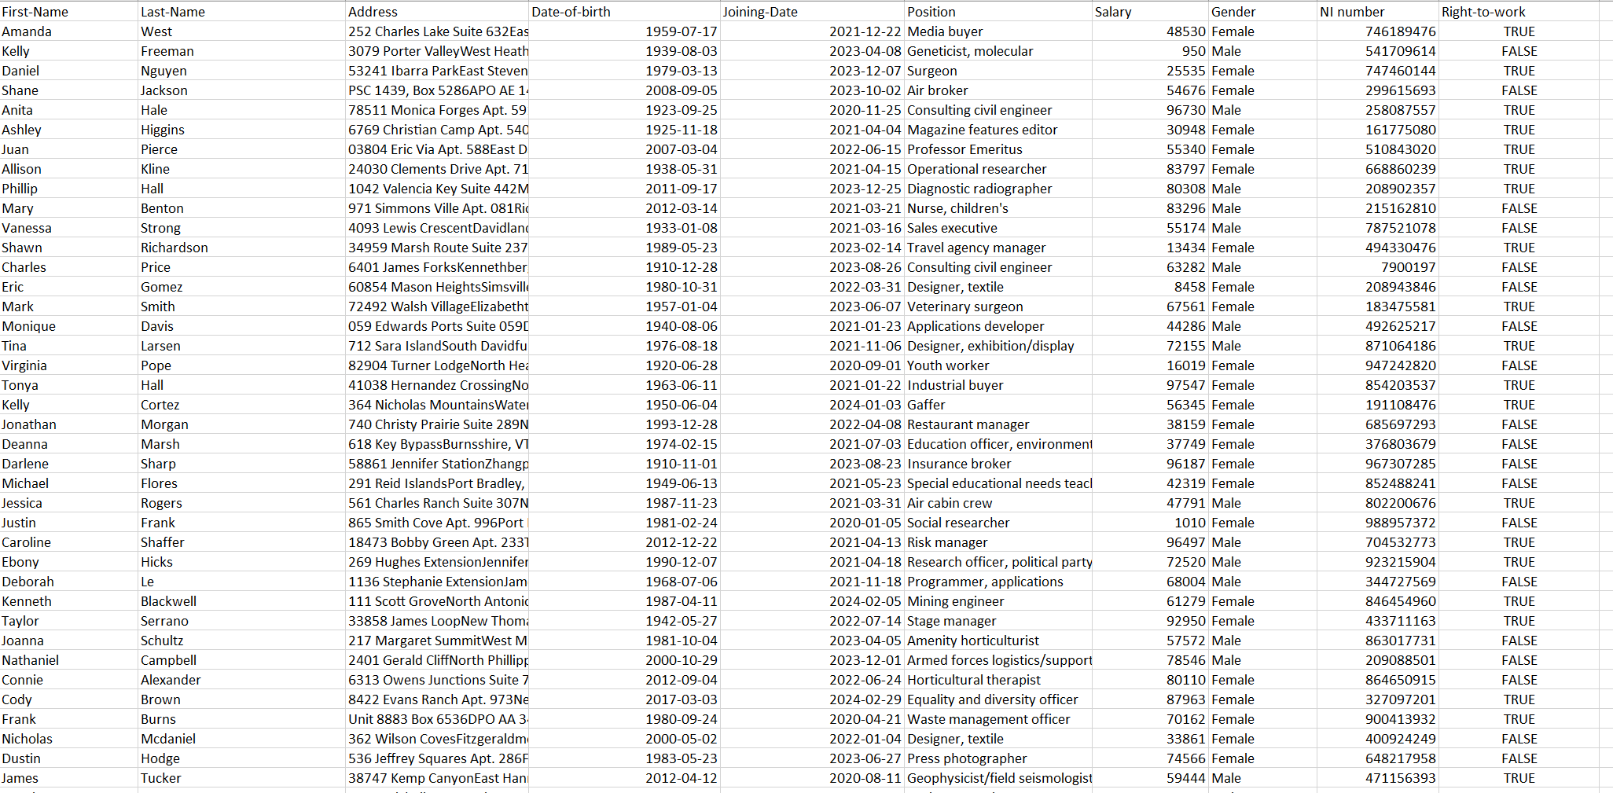
Wrong Column Names: Dob, Joining date & Address
Correction

Slide 9
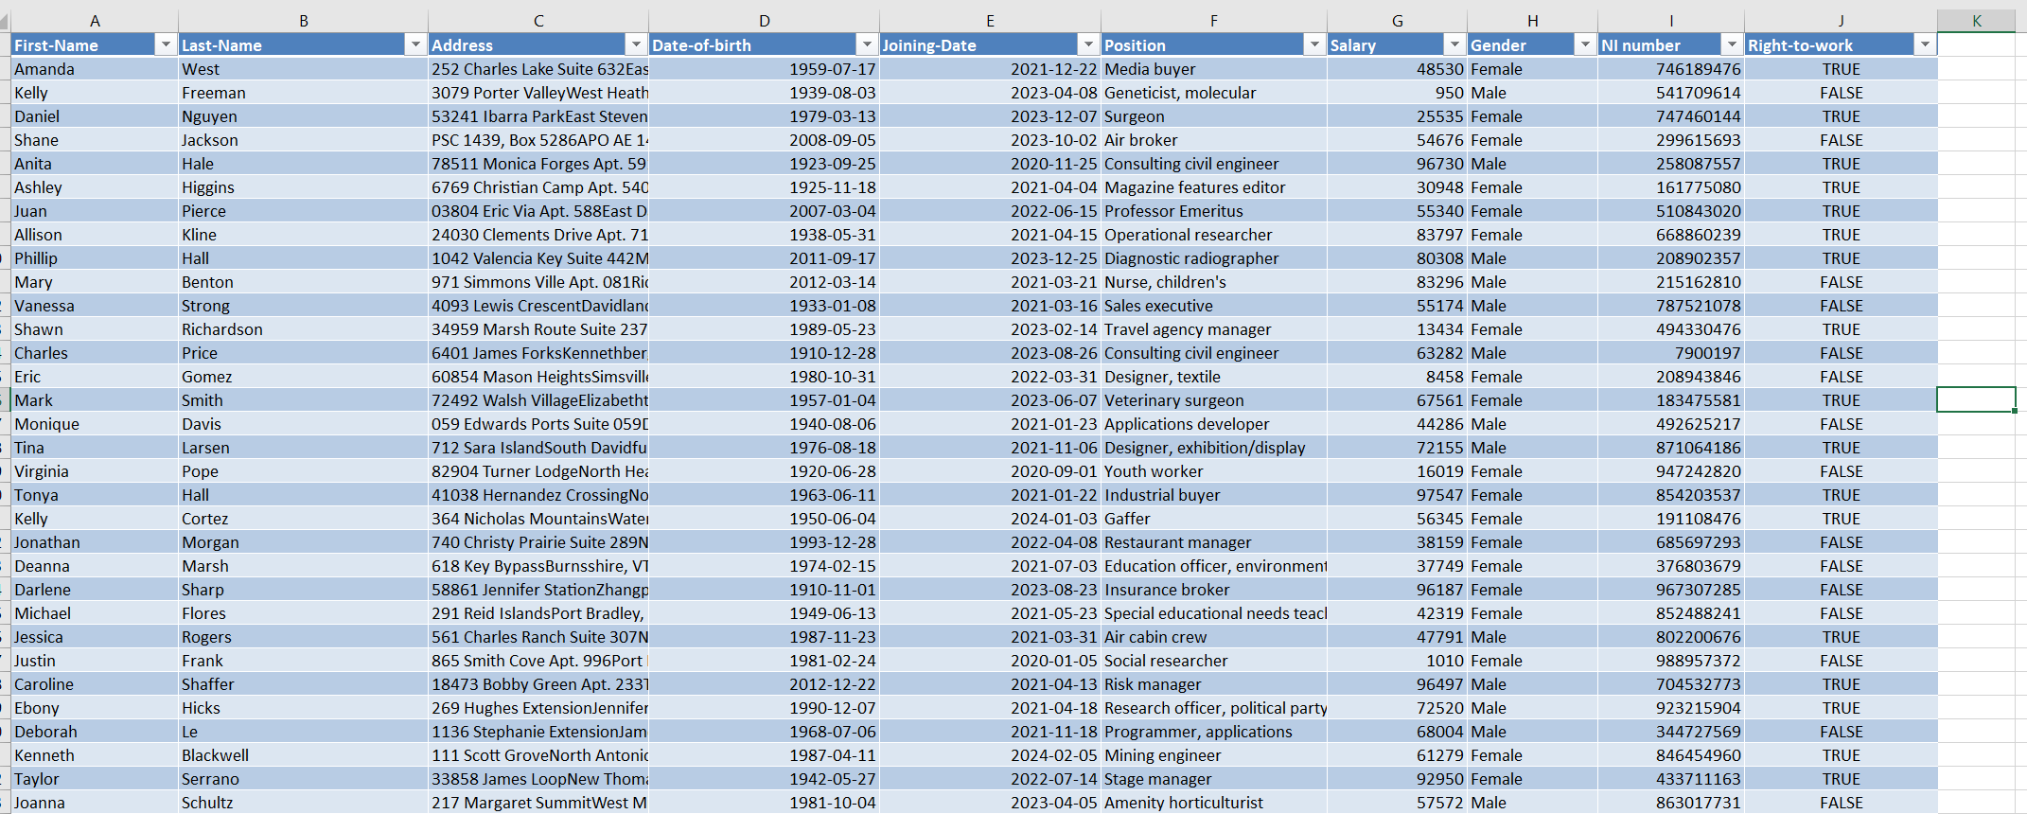
Table Creation
Data is not in table form.
Data is in table form.

Slide 10
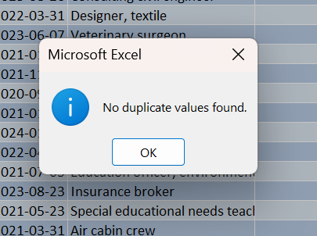
Remove Duplicated Data

Slide 11
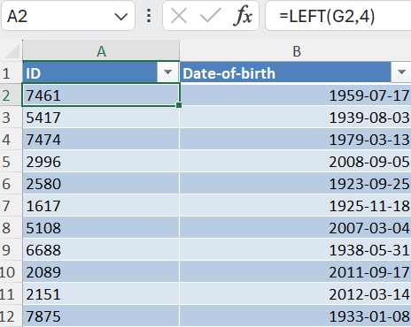
Create IDs
For this specific research names are not needed, therefore, I needed other form of identification. Which I decided to be the first 4 digit of the NI number as its unique.

Slide 12
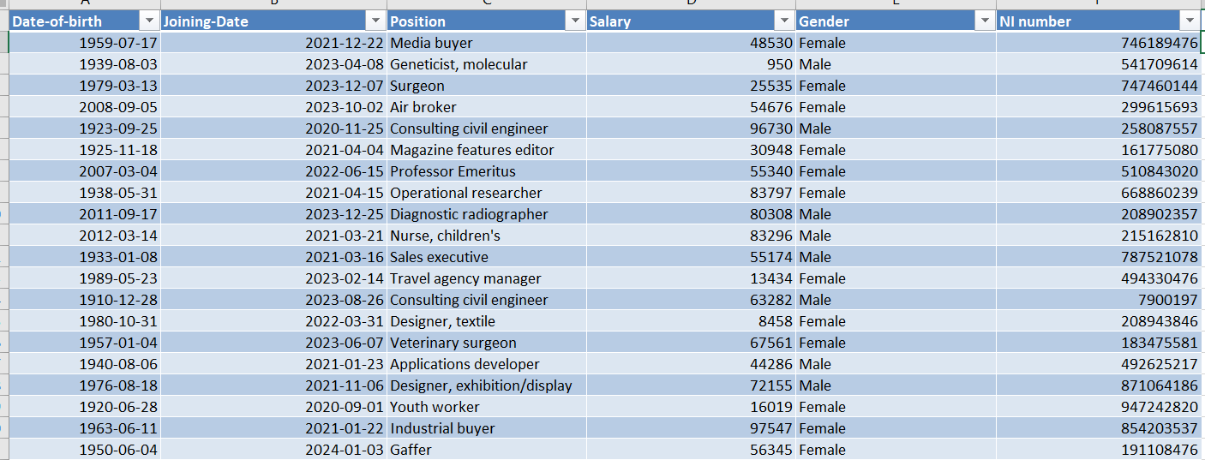
Prune Columns
These columns are not required for the analysis anymore, so, I deleted them.

Slide 13
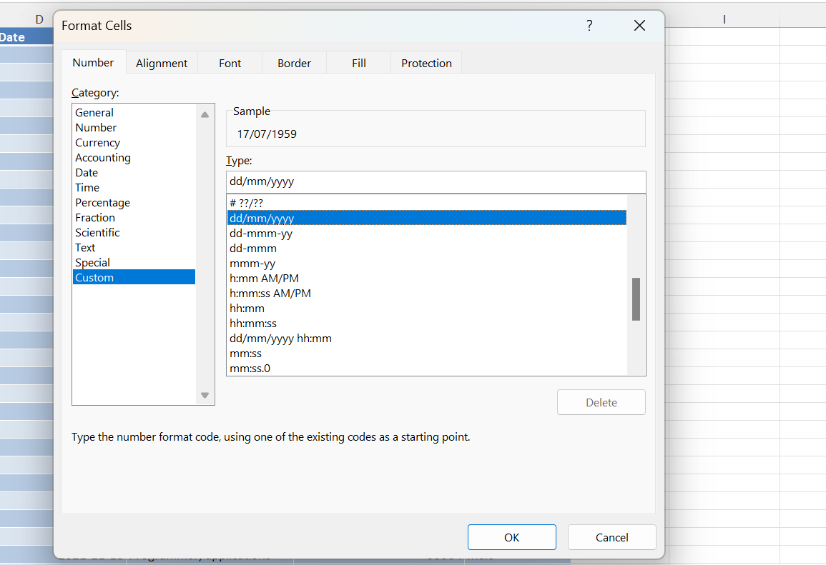
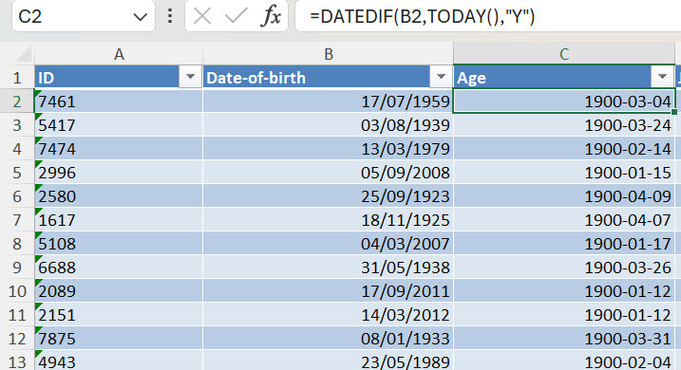
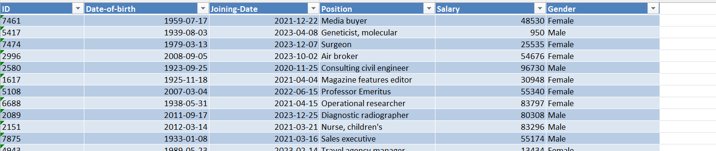
Date format
Changed the default date format to British Date format.

Slide 14
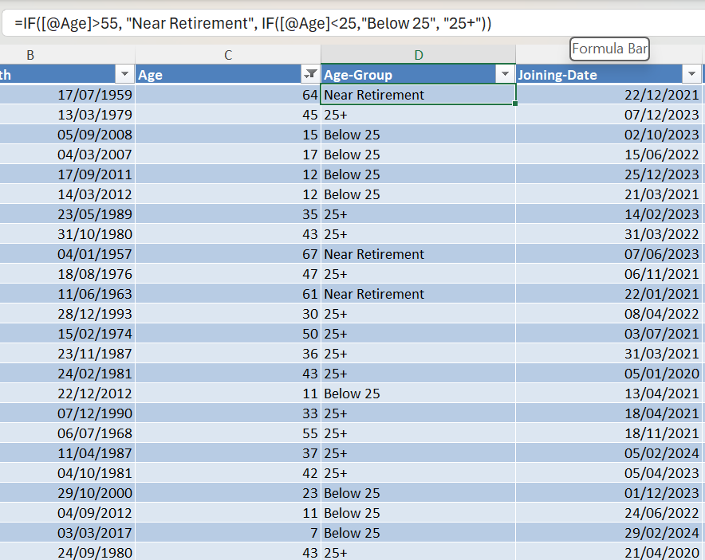
Calculated Age from DOB
Function

Slide 15
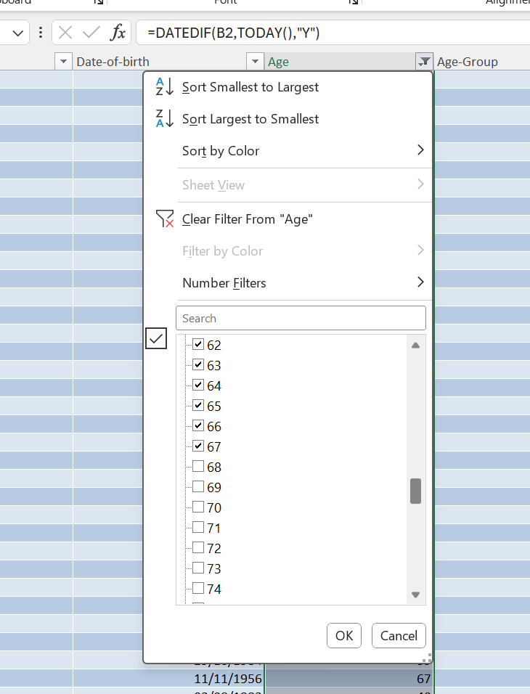

Remove Retired Employees
Due, to this the current count changed from 1000 to 566 unique records.
In UK, the current retirement age is 68, so, anyone above that is filtered out.

Slide 16
Categorise into Age Groups
Does age impact an employee’s earnings?
Do older employees people earn less?
Do younger employees people earn less?
To answer these questions, we need to transform age into categories. I used an if function to transform age into 3 nominal data categories, which are:
Below 25
Near Retirement (employee older than 55)
25+ (better variable name would have been “Between 25 & 55”)

Slide 17

Data Visualisation

Slide 18
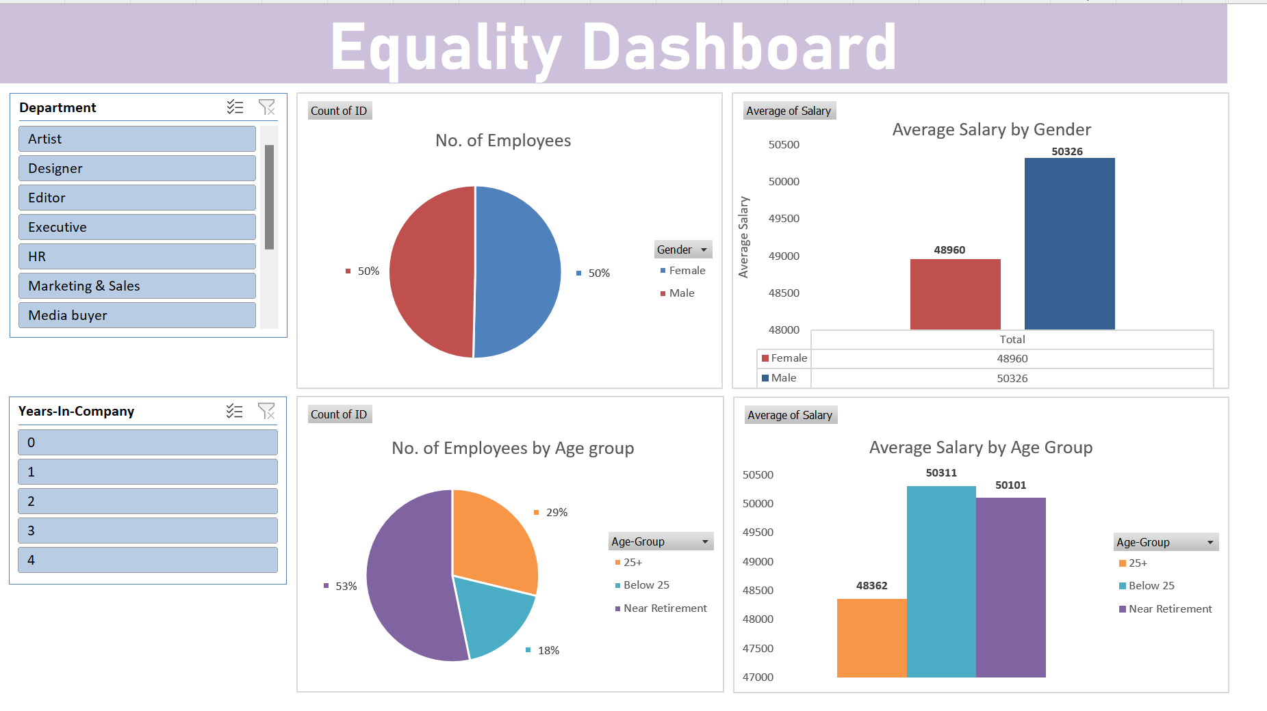
Used Pivot Tables, Slicers and Graphs

Slide 19
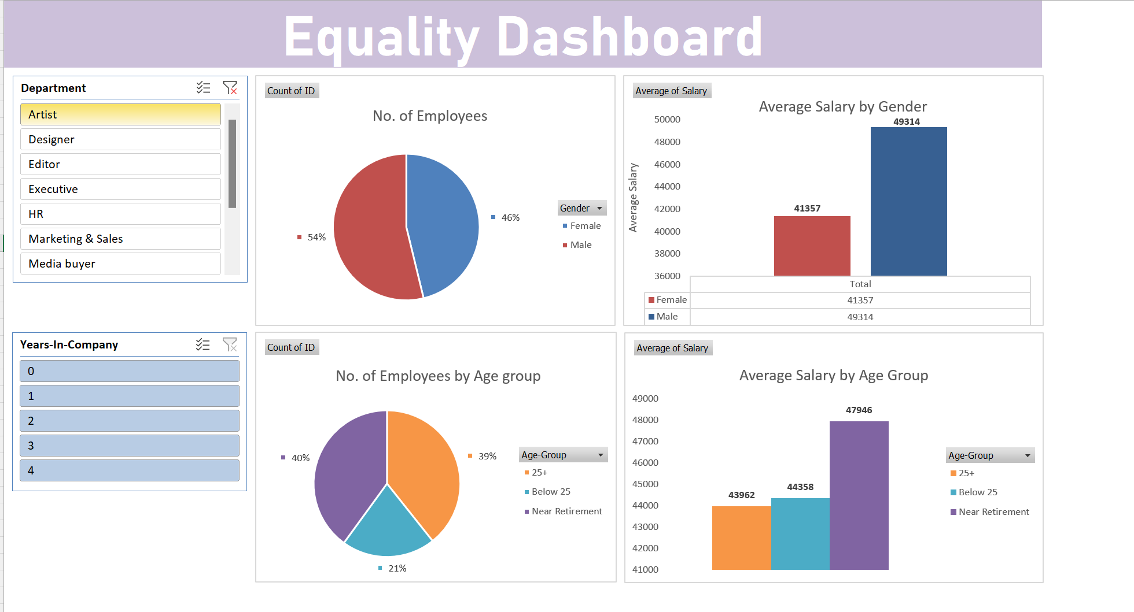

Slide 20
Data Driven Answers

Slide 21
Does the organisation hire more males than females or vice versa?
NO
The dashboard shows that there are same percentage of females and males within the company. The ratio of female to male is 1:1.

Slide 22
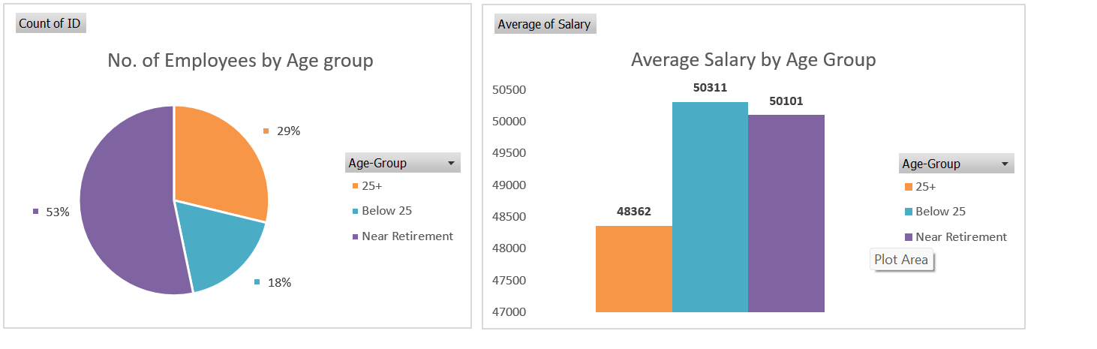
Does age impact an employee’s earnings?
Do older employees earn less?
Do younger employees earn less?
NO
The dashboard shows that employees near retirement earn more than employees 25+ of age.
NO
The dashboard shows that
younger employees earns more than employees above 25.

Slide 23
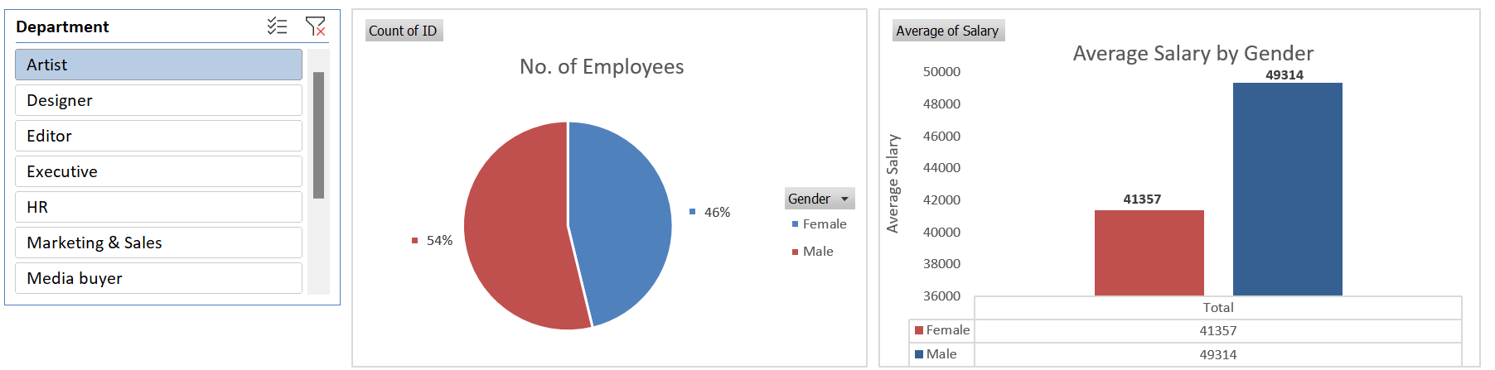
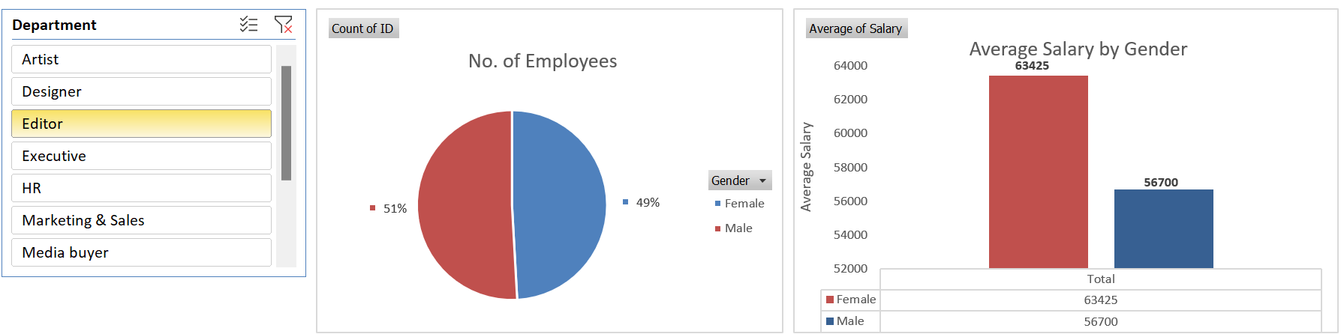
Does males get more salary than females in same position?
Yes, but depends on the department
The dashboard shows that in some department males get more salary than females and vice versa.
For example: In Editor department females earn more than males whereas in Artist department males earn more than females.

Slide 24
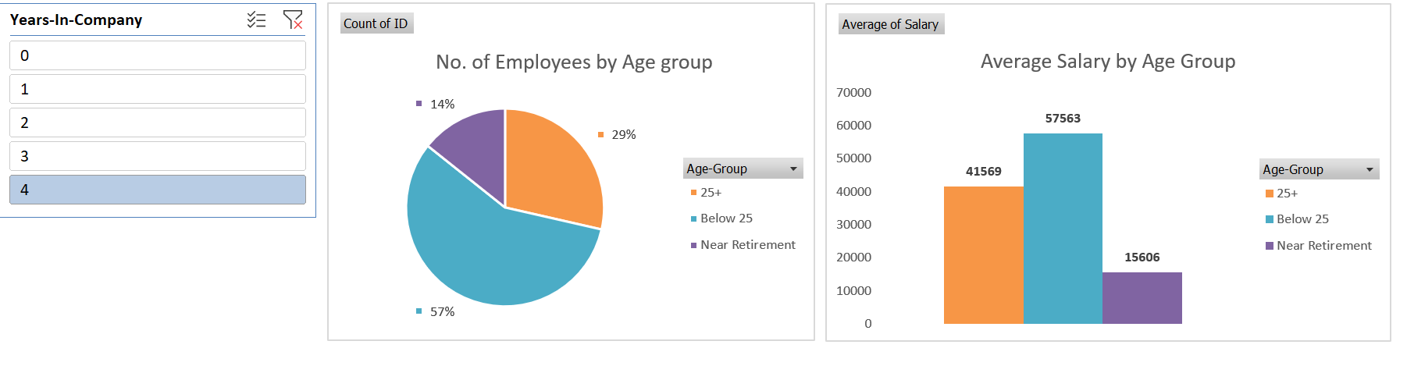
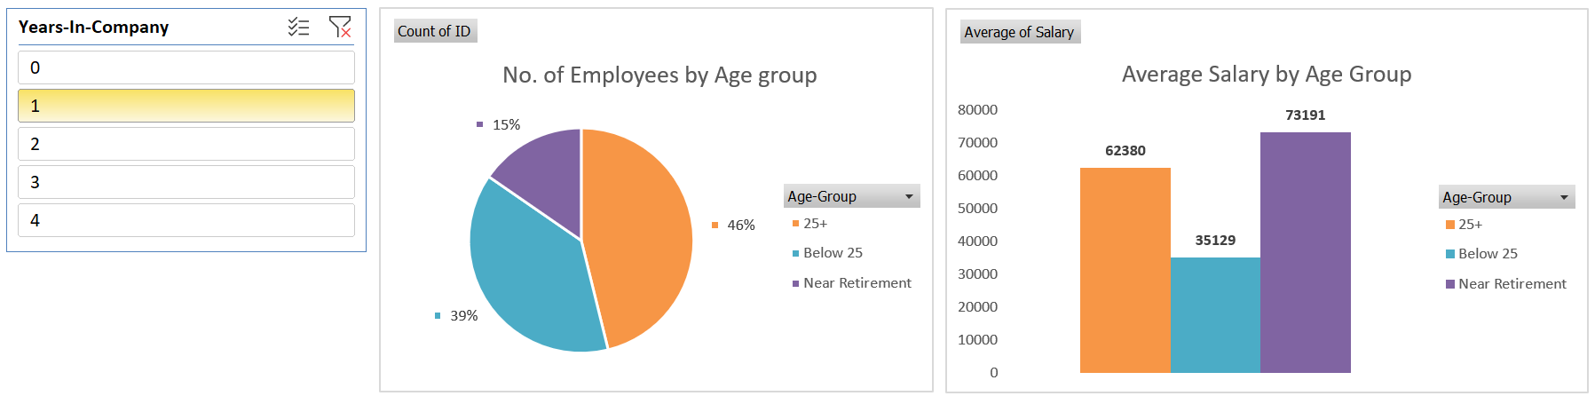
Does employees with longer time with the company get more salary than new joiners?
NO
The dashboard shows that employees with 1 year in the company averagely earns more than the employees with 4 year of experience within the company.

Slide 25
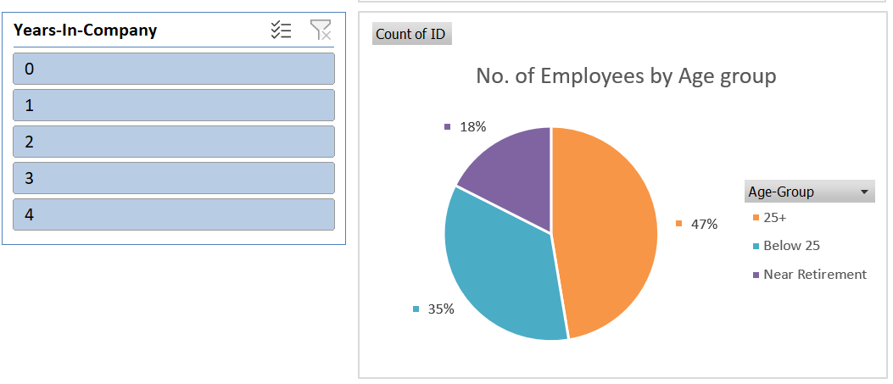
Are there more young employees than older employees?
Yes
The dashboard shows that relatively to employees who are near the age of retirement there are more young employees.

